Slide 1

Intro to APIs
Please connect to “muguest” wifi and accept the terms.
Goto: https://github.com/LauraBiss/apis_materials
Download the class materials and extract the files to your computer.
GDI Boise

Slide 2

Client Side APIs
What
Why
How

Slide 3
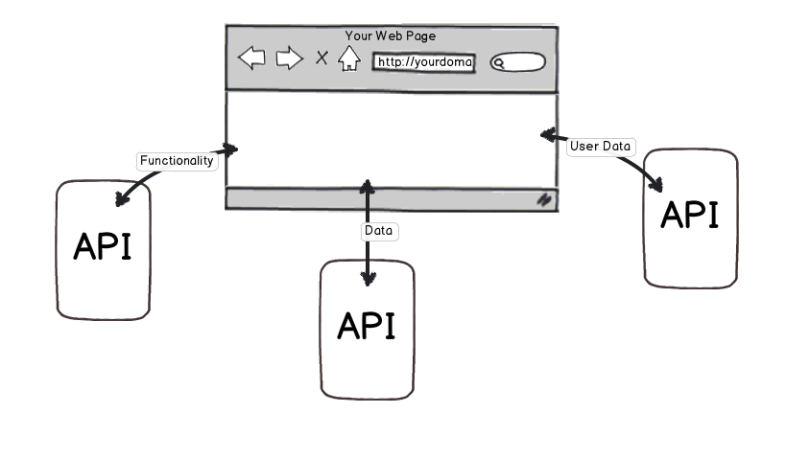
What is a web API?
Application Programming Interface

Slide 4
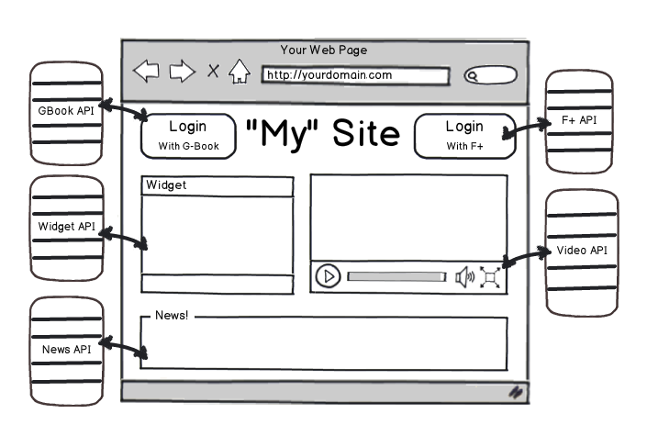
Why: Client Side APIs

Slide 5
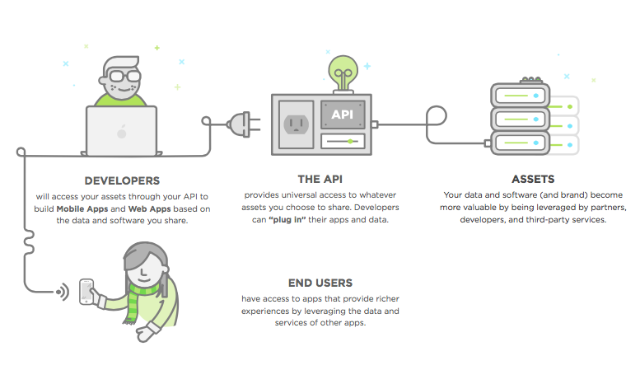
Client Side APIs: HOW

Slide 6
Exercise One: HTML APIs
In this exercise, you'll try out using several HTML APIs to add more dynamic content to the starter webpage.
Open the ExerciseOneStarter.html file. Open the webpage up in the browser and make sure it works. It should pull in video information from inline JSON data and display linked video thumbnails in a list.
Add a counter: Go to flagcounter.com and set up a hit counter for your website. Put the counter somewhere near the bottom of the page within a div using id=“counter”.

Slide 7
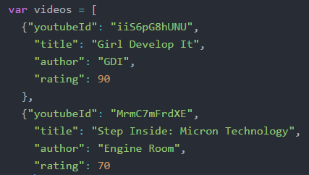

Rating Chart
Step 1: Add a "rating" field to each video in the inline JSON data.
Step 2: Go to the Google Gauge Charts API Docs and read about the Gauge Chart API parameters.
Step 3: Open the link to the JSFiddle example and notice the HTML portion is segregated from the JavaScript portion.

Slide 8
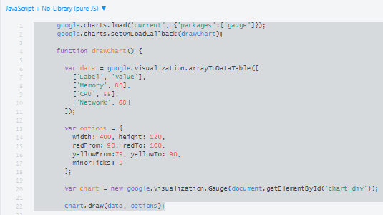
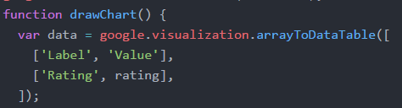
Add Rating Chart Continued…
Step 4: From the top of the JavaScript portion, copy the contents until you reach the setInterval function (lines 1-22).
Step 5: Rename the section titled “Memory” to “Rating”
and delete CPU and Network.
Step 6: Add the loader.js script to the header of the webpage and the chart div to the body of the webpage.

Slide 9
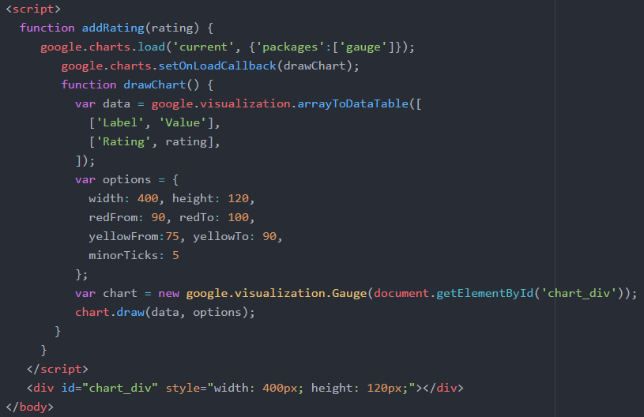
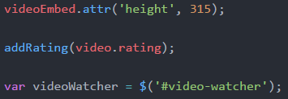
Add Rating Chart Continued…
Step 7: Add a script section to the body of the webpage and nest the JavaScript code within a function called addRating that accepts a variable called “rating” and assigns this variable to the rating field.
Step 8: Call the addRating function within the addVideoToList function.
Step 9: Save and test the web page. Click on the videos to test the new gauge chart. If it isn’t working open the console to check for errors.

Slide 10
Astronomy Picture of the Day
Visit NASA’s popular site at: https://api.nasa.gov/api.html#apod
This site loads in a different picture or video every day and provides an API for those who would like to retrieve the picture and associated information.
Sign up for an API key.
Open the apodStarter.html file in an editor.

Slide 11
Exercise Two: APOD
Replace the DEMO_KEY with your key.
Refresh the page and ensure it works.
Check console for errors if it isn’t working.
Change the date and refresh the page. Notice the picture and information change.

Slide 12
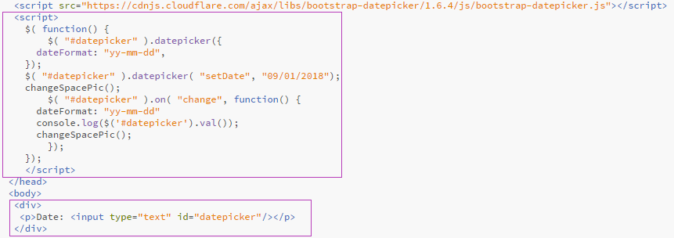
Exercise Two: APOD
In the header add the datepicker function.
In the body add a div, a paragraph and an input for datepicker.

Slide 13
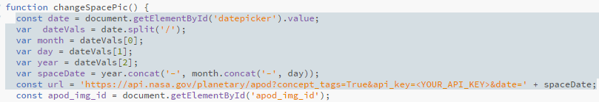
Exercise Two: APOD
Add JavaScript to format the date from datepicker and assign it to the variable “spaceDate”.
Append the url variable with “&date=‘ + spaceDate”

